Slide 1
IBM University Engagement Project Submission
“Exploring the Power of Machine Learning with IBM Cloud”

Slide 2

Project Tile – Network Intrusion Detection
Domain of Project – Cybersecurity
Student Name | Recent Passport Photo | Email ID | Mobile number [WhatsApp]
Devrshi Shailesh Yaduvansh |  | Devrshi.yaduvansh@gmail.com | 9987124856
Recommended font style and size: Font Style: Arial Font Size (Heading): 28
Font Size (Content): 20

Slide 3
Problem Statement -
Problem Statement: Network Intrusion Detection
Create a robust network intrusion detection system (NIDS) using machine learning. The
system should be capable of analyzing network traffic data to identify and classify various
types of cyber-attacks (e.g., DoS, Probe, R2L, U2R) and distinguish them from normal
network activity. The goal is to build a model that can effectively secure communication
networks by providing an early warning of malicious activities.

Slide 4
Proposed Solution -
Proposed Solution (IBM watsonx.ai Studio – AutoAI):
We propose an AI-powered Network Intrusion Detection System using IBM watsonx.ai Studio and AutoAI.
Network traffic data containing various connection features (protocol type, service, duration, source bytes, destination bytes, connection flags, etc.) will be collected and uploaded to watsonx.ai.
AutoAI will automatically perform data preprocessing, feature engineering, algorithm selection, and hyperparameter optimization.
Multiple classification models will be generated and evaluated to identify the best-performing model for network intrusion detection.
The selected model will classify network traffic as Normal or identify different types of cyberattacks such as DoS (Denial of Service), Probe, R2L (Remote-to-Local), and U2R (User-to-Root), enabling early detection of malicious activities and enhancing network security.

Slide 5
Technology Used
IBM Cloud – It provides the infrastructure to build, deploy, and scale the Nutrition Agent efficiently. IBM Cloud enables a reliable, secure, and scalable environment for deploying the Nutrion agent
ML Algorithm/ Model Used: WatsonX (WatsonMachineLearning)
Accuracy Obtained: _________________________
Enhancements and Hyperparameter tuning: _______________________

Slide 6
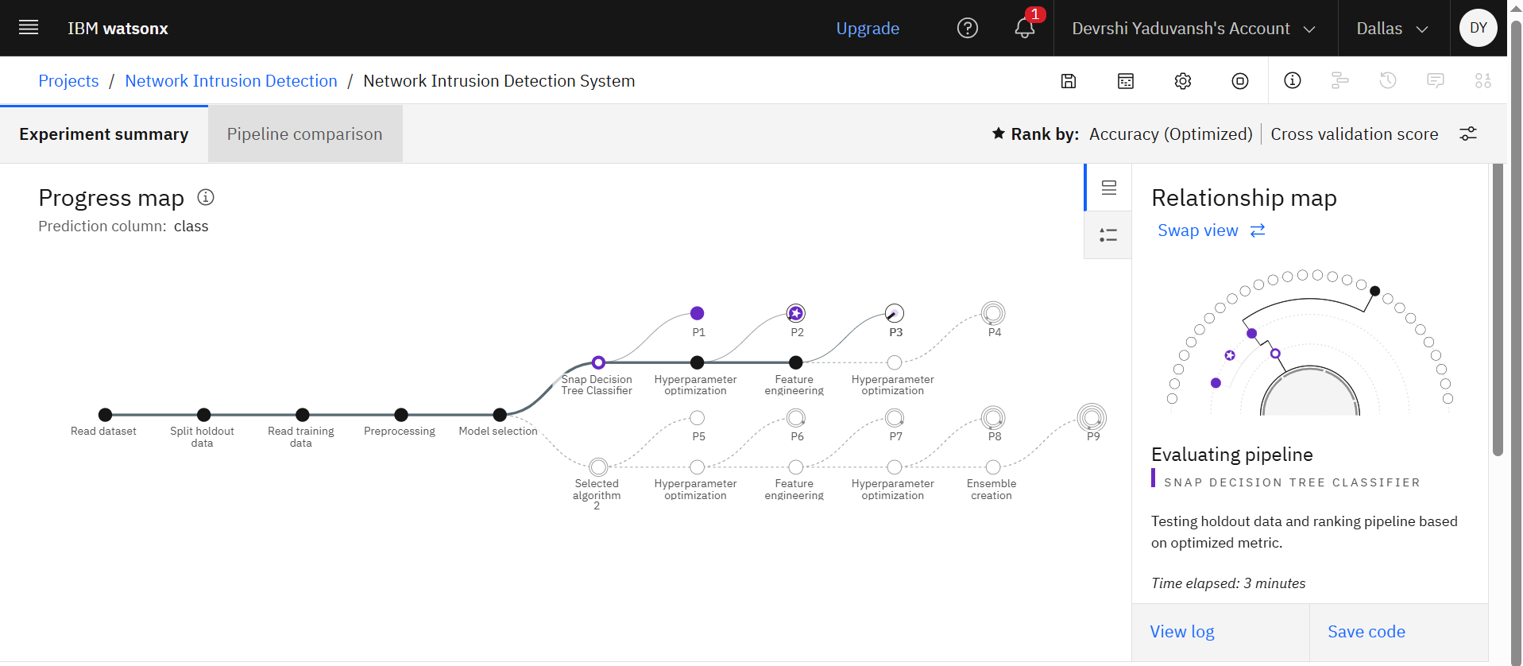
Training Screenshots-

Slide 7
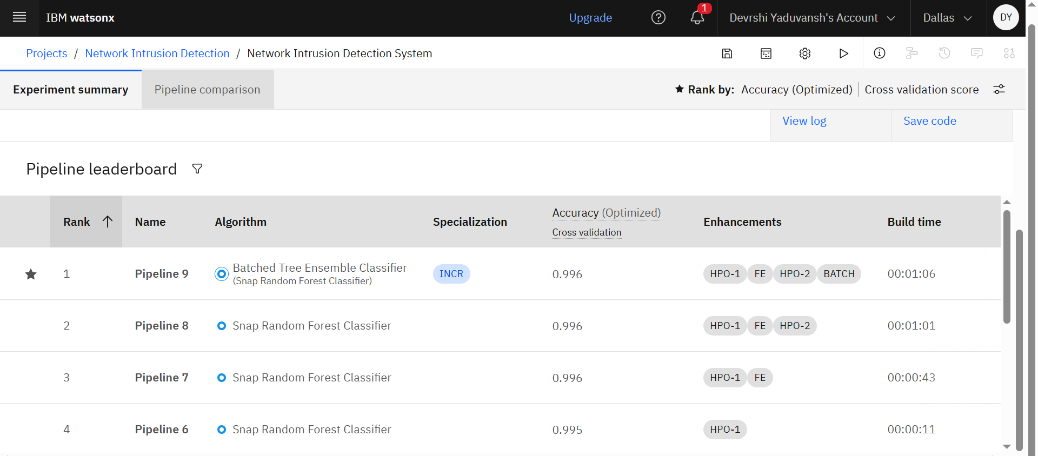
Best Model Screenshot:

Slide 8
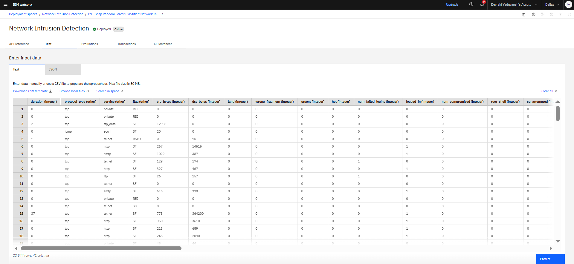
Testing Screenshot:

Slide 9
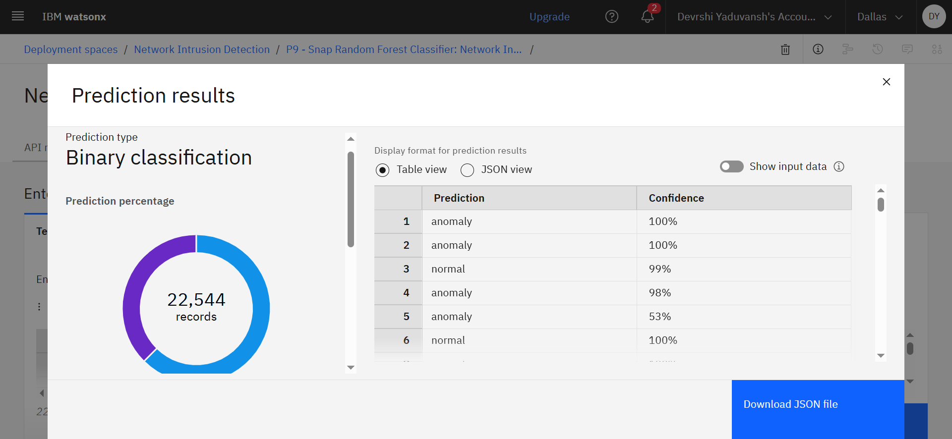
Testing Screenshot:

Slide 10
Novelty and Uniqueness
The solution automates the detection and classification of malicious network traffic, enabling faster identification of cyber threats and reducing manual monitoring effortsIt uses IBM watsonx.ai AutoAI to automatically discover the best machine learning model without extensive coding.
It leverages IBM watsonx.ai AutoAI to automatically perform data preprocessing, feature engineering, algorithm selection, and hyperparameter optimization with minimal coding.
The system intelligently classifies network traffic into Normal, DoS, Probe, R2L, and U2R attack categories using a single AI-powered platform.
Automated feature engineering uncovers hidden patterns in network traffic, improving the accuracy and reliability of intrusion detection.
The model provides consistent, real-time, and unbiased threat detection, helping organizations strengthen network security while minimizing false alarms and human error.

Slide 11
Git Hub Link
Please create public github repository (Enable Add README button while creating repository) with format –
Please test and Paste the working Github URL – https://github.com/KOBA-Devrshi/IBM-Edunet-Final-Prpject
Make sure you have Uploaded following three files into your github repository 1) Data.csv file, 2) yourproblemstatement.pdf file 3) your project presntation.pptx file 4) Python Notebook downloaded from IBM Cloud
·
·
·

Slide 12
Future Scope
The system can be enhanced to support real-time network traffic monitoring for continuous intrusion detection in enterprise environments.
Advanced Deep Learning and Explainable AI (XAI) techniques can be integrated to improve detection accuracy and provide transparent threat analysis.
The solution can be expanded to detect zero-day attacks and previously unseen cyber threats using anomaly detection and adaptive learning.
Integration with Security Information and Event Management (SIEM) platforms and cloud infrastructures can enable automated threat response and centralized security monitoring.
Future versions can incorporate IoT and 5G network security, making the system suitable for protecting smart devices, industrial networks, and next-generation communication systems.
·
·
·

Slide 13
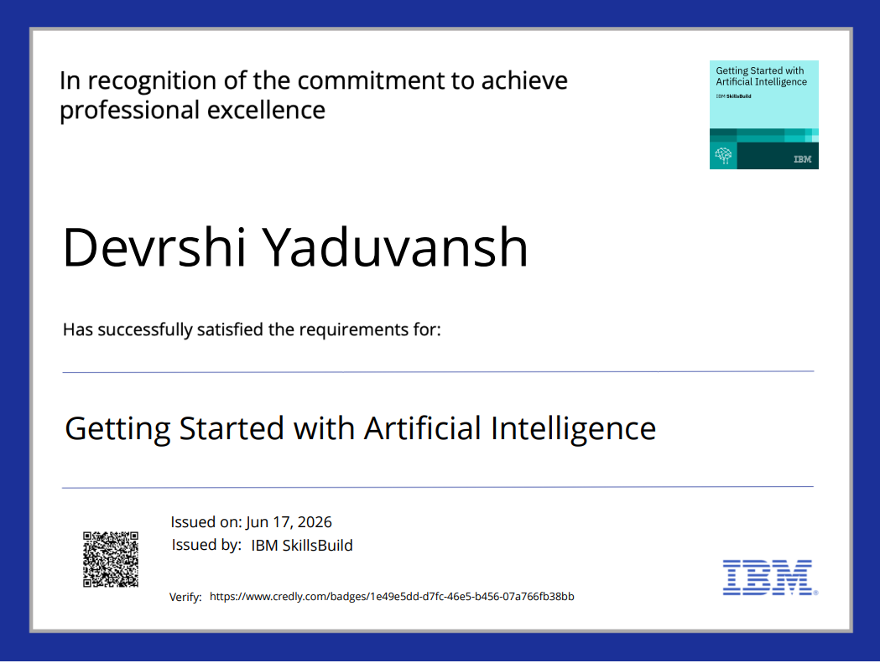
Certificates Earned:
Please add your credly certificate

Slide 14
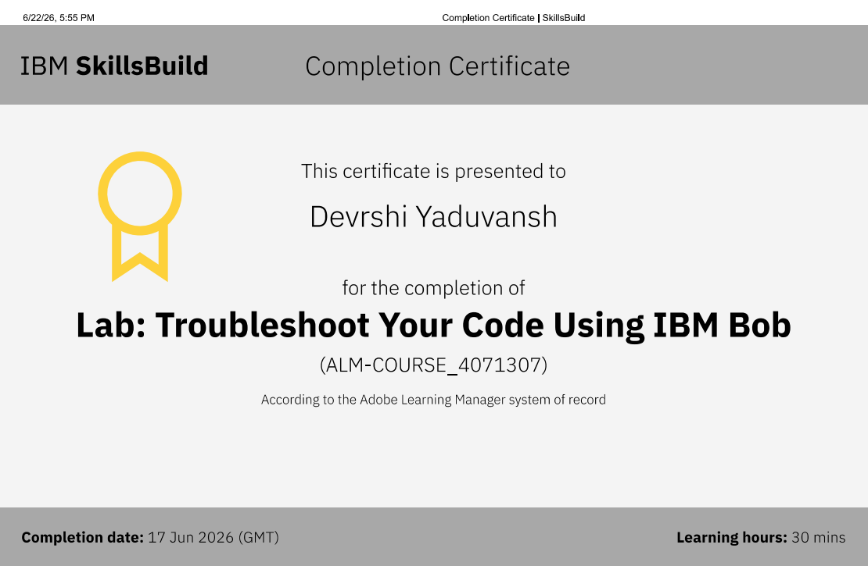
Certificates Earned:​
Add your IBM BOB Certificate

Slide 15


